Slide 1
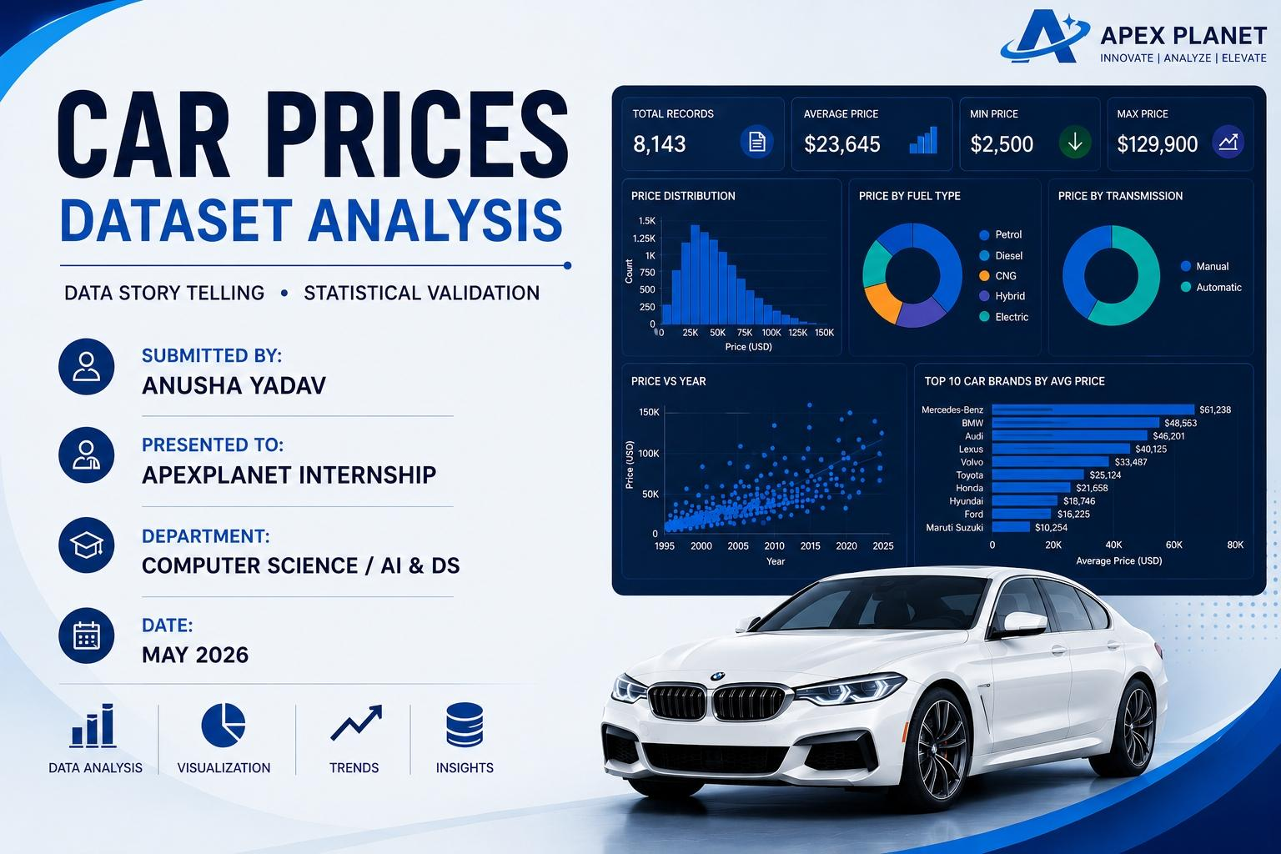

Slide 2

Business objective
Analyze car price trends
Identify key pricing factors
Compare vehicle features and prices
Discover market patterns through visualization
Support data-driven decision making
Understand vehicle depreciation trends
Identify popular and high-value car segments
Build an interactive analytical dashboard

Slide 3
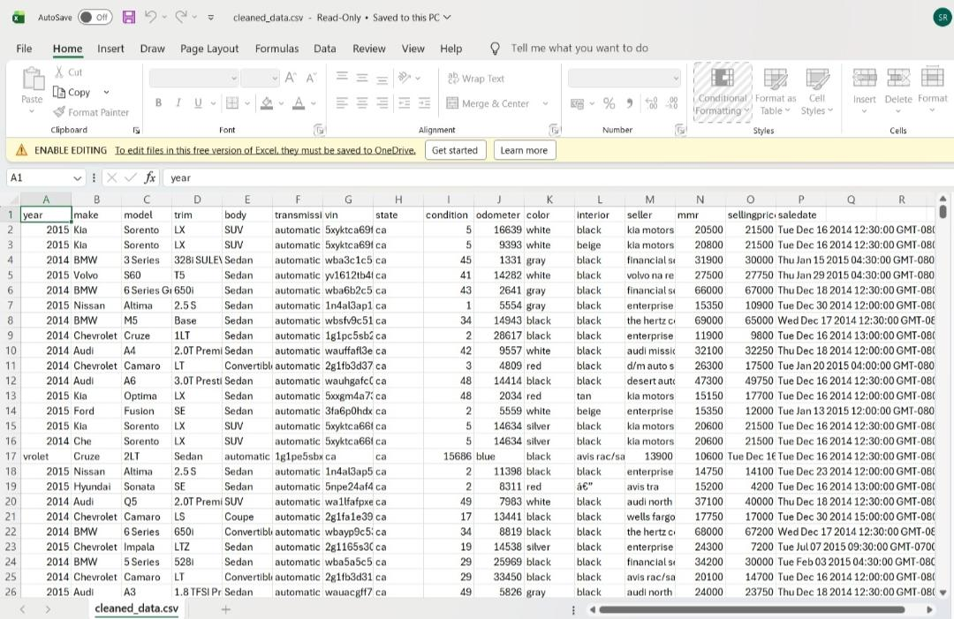
Data Overview
Dataset Name
Car Prices Dataset
Key Features
Brand, Model, Year, Price, Fuel Type, Transmission, Mileage, Engine Size, Location
Tools Used
Python, Pandas, NumPy, Matplotlib, Seaborn, Power BI, Jupyter Notebook

Slide 4
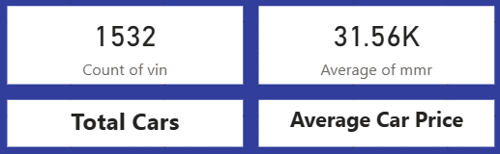
Key Business KPIs
Total Cars – 31.12K
Average Car Price – 11.21K

Slide 5
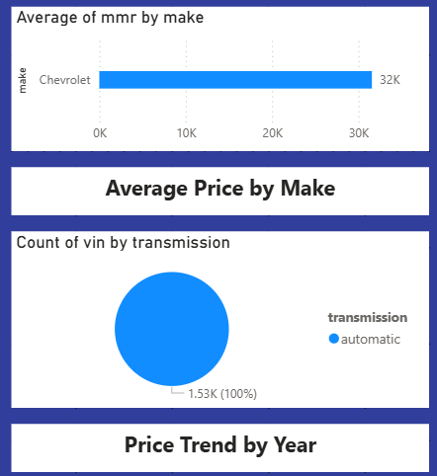
Sales Performance Analysis
Analyze overall car sales performance
Identify top-selling car brands and models
Compare sales across fuel and transmission types
Track price-wise sales distribution
Discover high-demand vehicle segments
Support better sales and pricing strategies

Slide 6
Price Trend Analysis
Year-wise car price trends
Increase/decrease in pricing patterns
Market demand observations
Impact of vehicle age on pricing
Brand-wise price comparison
Seasonal and market trend insights

Slide 7
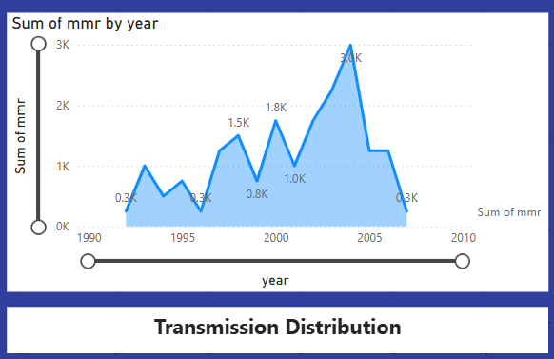
Transmission Analysis
Manual vs automatic price comparison
Transmission-wise market demand
Popular transmission types
Pricing trend analysis
Sales performance by transmission
Customer preference insights

Slide 8
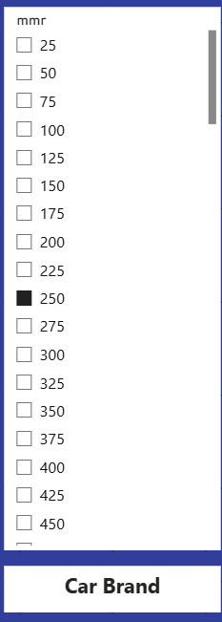
Brand Analysis
Top car brands analysis
Brand-wise average pricing
Market performance insights
Popular brand comparison
Brand demand trends
High-value brand identification

Slide 9
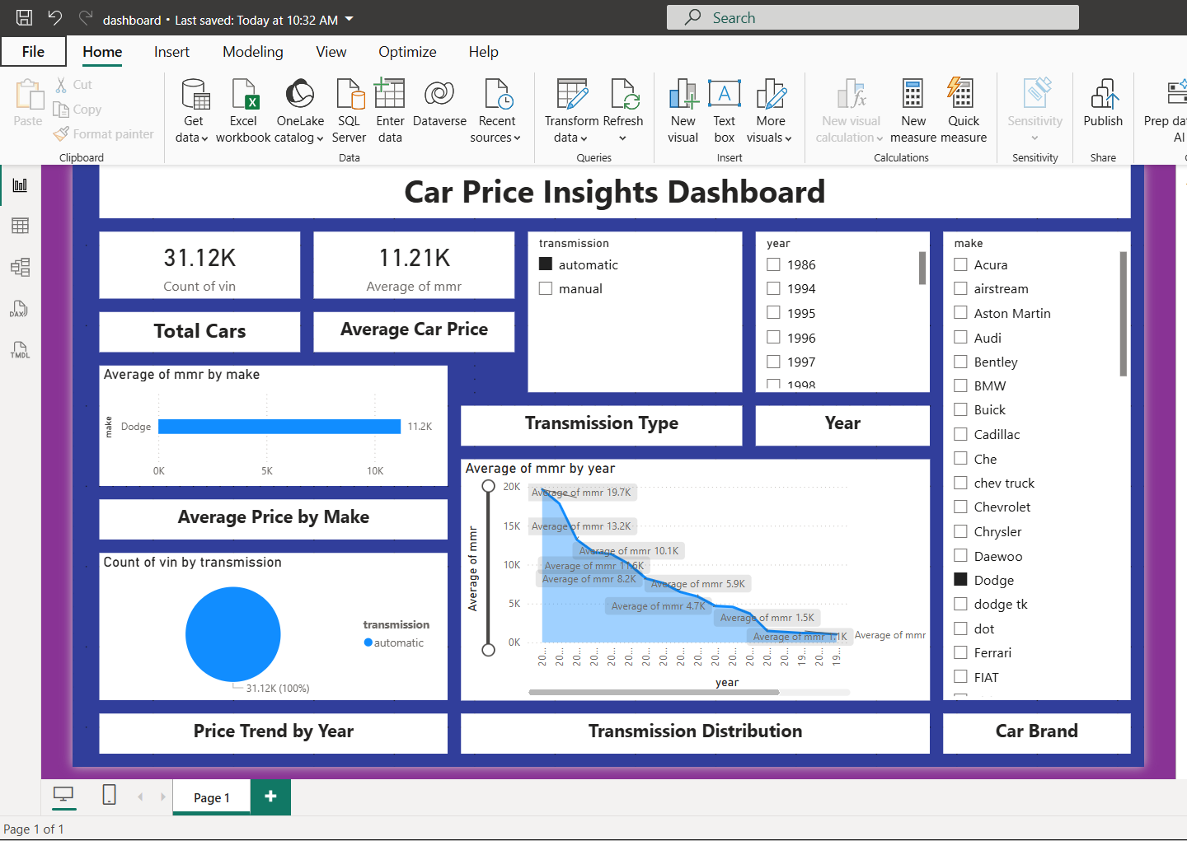
Dashboard Insights
Car prices vary across brands and vehicle types
Automatic cars have higher average prices
Newer vehicles show higher market value
Fuel type impacts pricing and demand
Premium brands dominate market performance

Slide 10
Business Recommendations
Focus on high-demand vehicle segments
Optimize pricing based on market trends
Promote premium and automatic vehicles
Monitor brand-wise sales performance
Use data insights for better business decisions

Slide 11
Conclusion
Car prices are influenced by brand, vehicle age, fuel type, and transmission.
Market trends show higher demand for premium and newer vehicles.
Data visualization helps identify pricing patterns and customer preferences.
The dashboard supports effective pricing and sales decisions.

Slide 12


